Slide 1
EVENTIVE
Turma 3 - Grupo 3

Slide 2
Principais Funcionalidades
Create and edit events.
Create and edit notes.
Create and edit alarms.
Select interests and add events based on them.

Slide 3
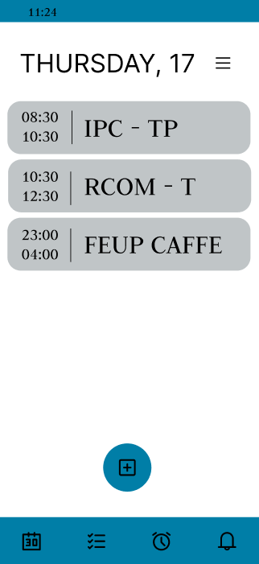
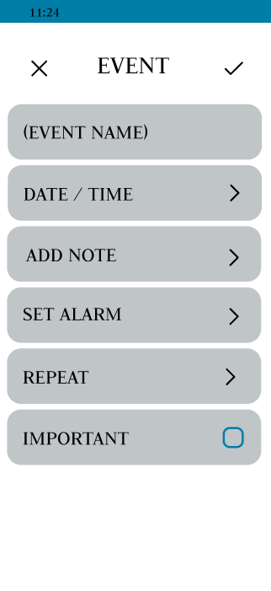
Wireflow – Create Events

Slide 4
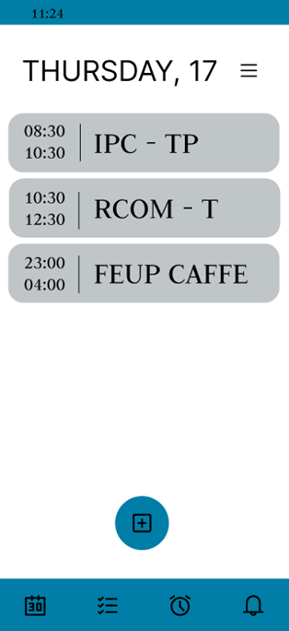
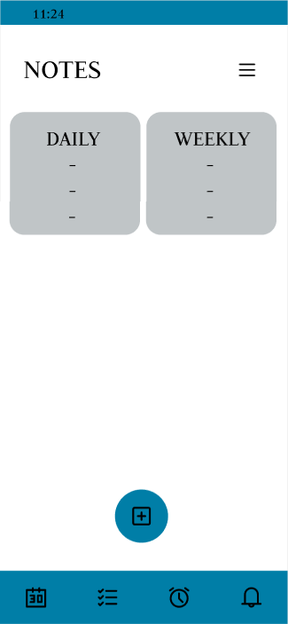
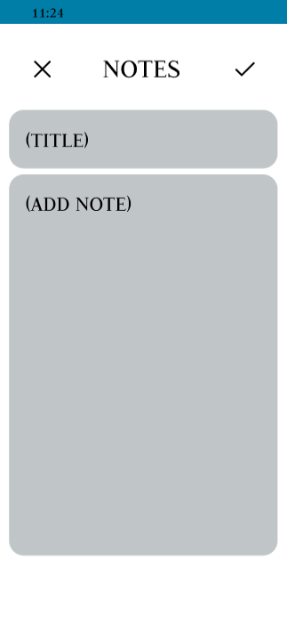
Wireflow – Create Notes

Slide 5

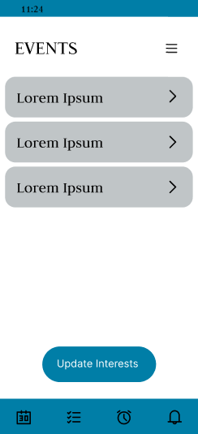
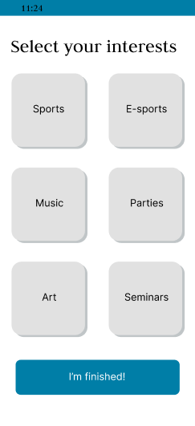
Wireflow – Update Interests

Slide 6
Heuristic Evaluation Results
The main problems identified on the prototype were:
Lack of clarity regarding some buttons functinalities.
Not intuitive button usage.
Mismatched app navigation.
The avarage severity was 2,1.

Slide 7
Corrections to Perform in Phase 3
The focus on problema 1 was returning to previous pages so we added “go back” buttons in the ones it was needed.
On problem 2, we made the entire button section clickable instead of only the arrow.
To solve problem 3, we simply made sure that the buttons navigate to where they are supposed to.
To manage other existing problems, we encourage users to read the tutorial we provided.

